Slide 1
Two-Sample Z Test for P
Inferences About Proportions of Two Groups

Slide 2
Testing the Difference Between Two Proportions
Examples:
You wish to compare the defective rates (a proportion) of two companies that supply the computer chips needed for your tablet computer.
You want to compare the death rates for heart transplants at two hospitals.
You want to compare the graduation rates of two high schools in the same area.

Slide 3
Testing the Difference Between Two Proportions
We are trying to determine whether the observed difference between two proportions is statistically significant or just sampling error.
We use a two-sample Z test to compare the proportions (P) of two groups.
To use this test n₁ and n₂ should be large. Specifically,
n₁p₁ ≥ 5
n₁(1-p₁) ≥ 5
n₂p₂ ≥ 5
n₂(1-p₂) ≥ 5

Slide 4
The Two-Sample Z Test for P
This Z test uses the normal approximation:

Slide 5
The Two-Sample Z Test for P
P_{s1}= = the sample proportion in population 1
P_{s2}= = the sample proportion in population 2
Where
X₁ represents the # of “successes” in sample 1
X₂ represents the # of “successes” in sample 2
A “success” is the outcome you are interested in, e.g., a defective part.
n₁ = sample size for group 1
n₂ = sample size for group 2
is the pooled estimate of the population proportion:

Slide 6
Problem 1: Death Rates at Two Hospitals
We would like to compare the death rates from liver transplants at two hospitals in similar areas.
Hospital A: 77/100 died within 6 months
Hospital B: 120/200 died within 6 months
Are the death rates for the two hospitals statistically different? Test at α = .05.

Slide 7
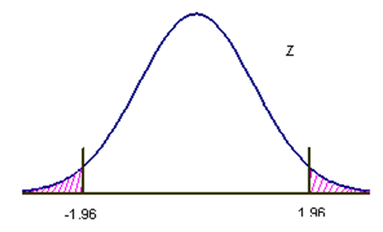
Problem 1: Death Rates at Two Hospitals (cont’d)
H₀: P₁=P₂
H₁: P₁≠P₂
P_{s1} = 77/100 = .77; P_{s2} = 120/200 = .60
_{Z=}
Reject H₀

